Slide 1
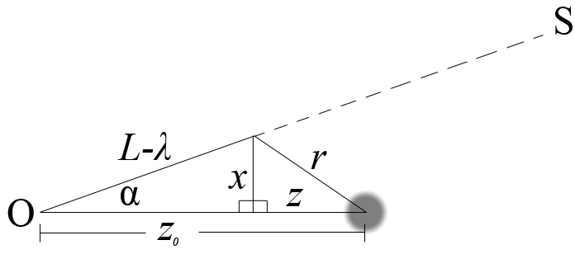
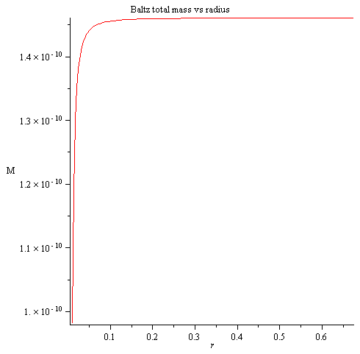
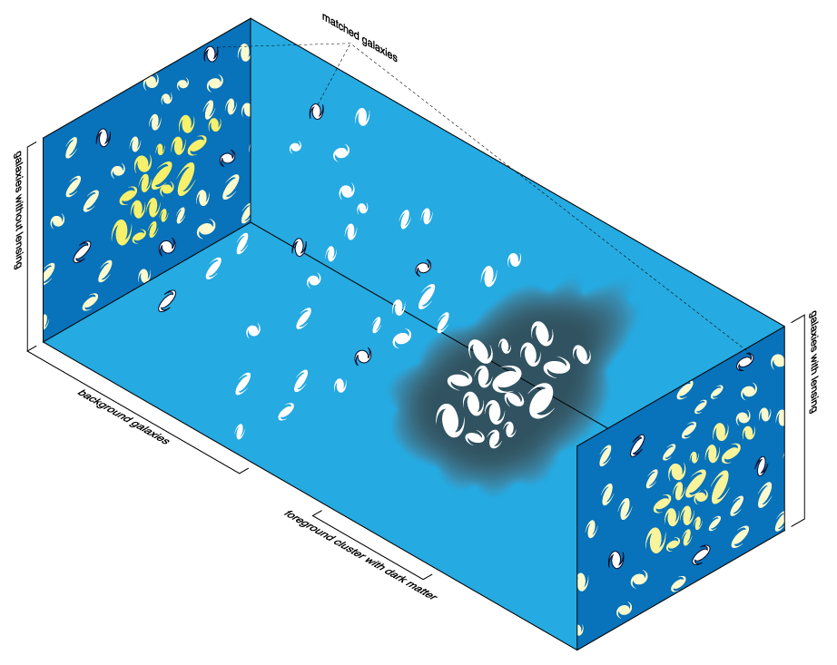
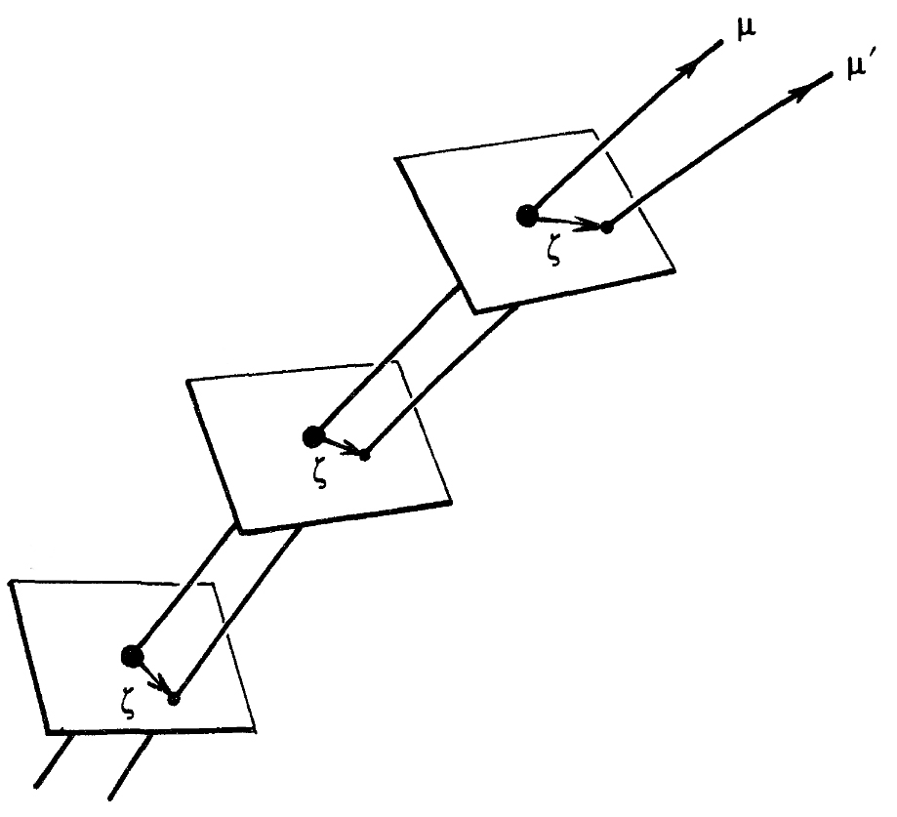
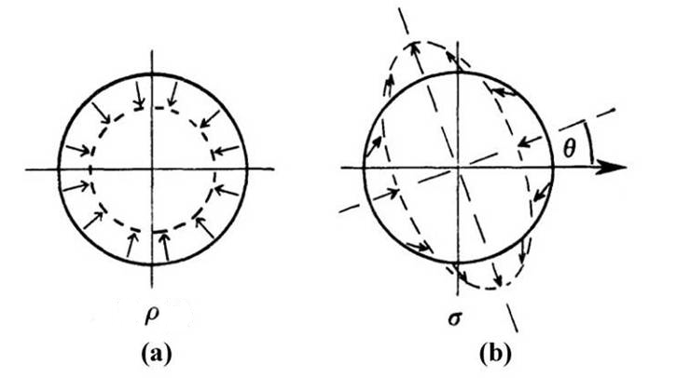
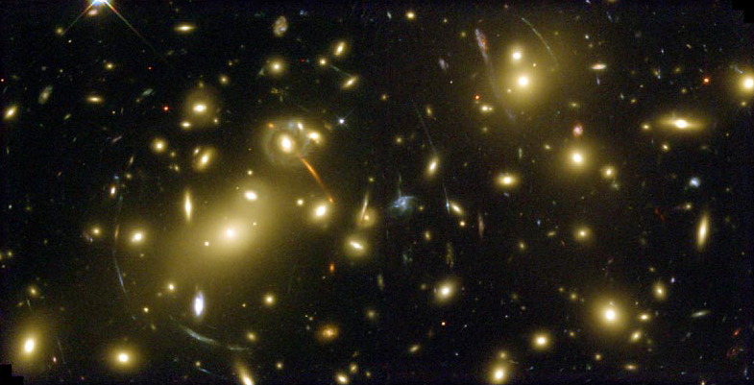
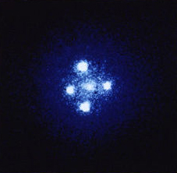
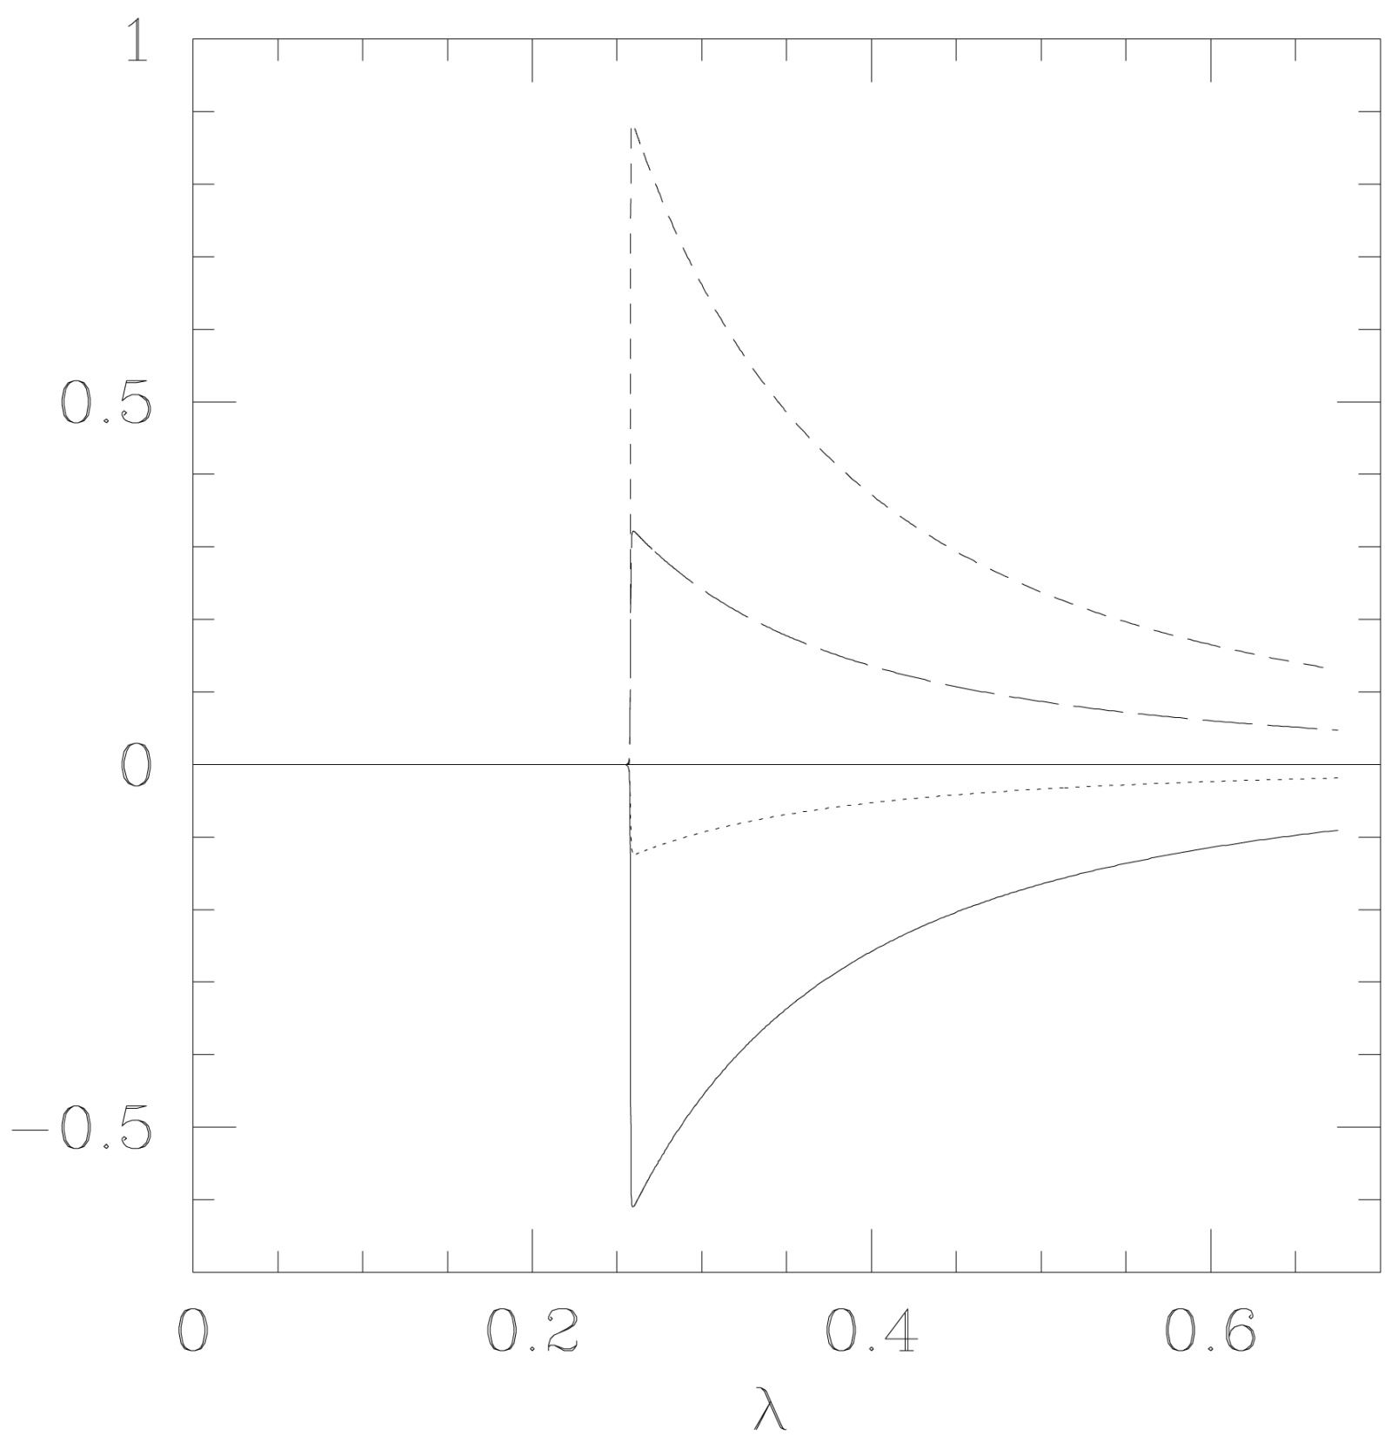
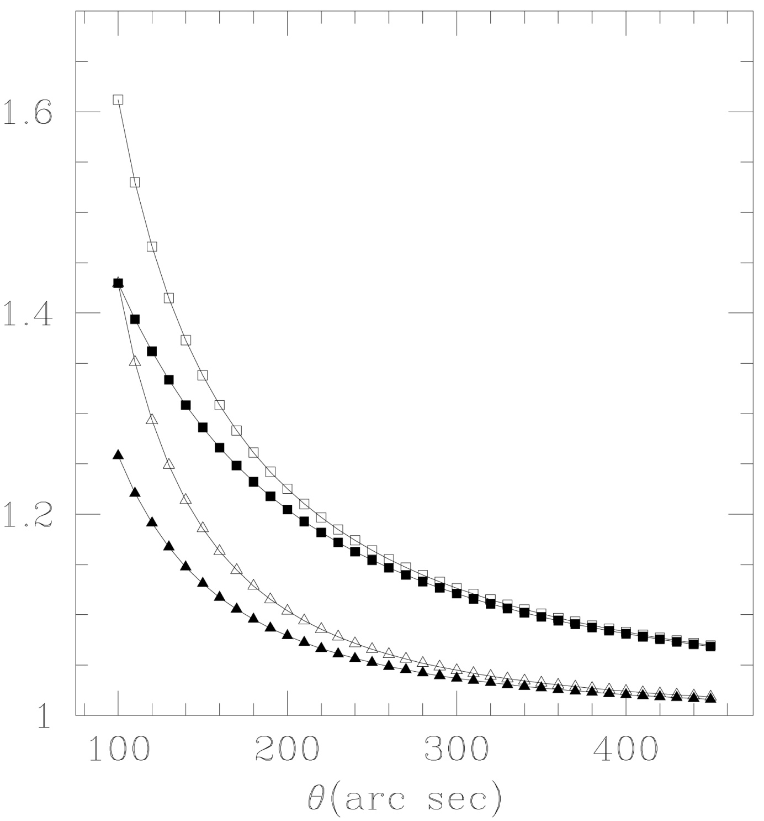
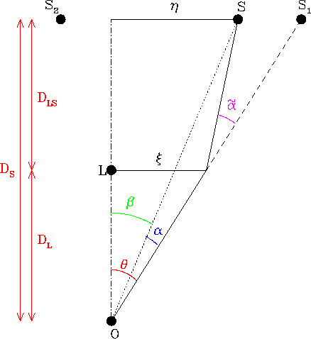
Optical Scalar Approach to Weak Gravitational Lensing by Thick Lenses
Louis Bianchini
Mentor: Dr. Thomas Kling
Department of Physics, Bridgewater State College, MA 02325
Abstract
Research Goals
Results
We assume a thick gravitational lens governed by a Baltz n=1 matter density model. From the gravitational potential we then derive expressions for a Weyl tensor component and Ricci tensor component. A pertubative approach is taken to solve for the convergence and shear as given by Sach's equation. By applying the geodesic deviation equation to a bundle of light rays with our expressions for the optical scalars we were able to derive expressions for the image shape and size at any point along the path from source to observer, in the case of an axially symmetric lens and source.
Our research was designed to find out:
What the difference between a fully 3-D mass and a projected 2-D mass has on weak gravitational lensing.
Since weak lensing often occurs with galaxy clusters, can we find a way to model weak gravitational lensing using multiple lenses that the thin-lens approximation cannot handle
Our Approach Using Thick-Lenses
What is Gravitational Lensing?
We used a truncated Navarro-Frenk-White (NFW) matter distribution model described by Baltz et al. :
FIG. 7: Geometry for our equations. The lensing galaxy is represented by the black circle. Light rays from S reach the observer at O. The angle α is between 100 and 600 arcseconds. The affine parameter λ is 0 at the source and L at the observer.
Image Area and Shape
We then solved for gravitational potential, , by
If we consider two light rays leaving the same source, the geodesic deviation equation is written as:
and
FIG. 5: Total mass vs. radius in the Baltz et al. matter distribution model.
Optical Scalars
FIG. 6: The optical scalars. Divergence, ρ, describes the rate at which the overall image is being focused. Shear, σ, describes the rate at which the image is rotated and becomes elongated. These quantities are used in Sach’s Equations.
The geodesic deviation equation is also treated perturbatively. We ultimately obtained the following relationships for image area, A, and shape (ratio of axes in the elliptical image).
We have chosen to model an elliptical image using the complex quantity ζ, where a and b correspond to semi-major and semi-minor axes.
The relationships obtained were:
FIG. 1: The effect of a gravitational lens on background galaxies. The matched galaxies in white appear slightly larger and are rotated.
FIG. 8: The geodesic deviation equation describes how the two light rays (μ, μ’) will differ from each other. From this, we can obtain information about the image.
Newman-Penrose Spin Coefficients
Newman-Penrose (NP) spin coefficients of interest were defined by:
FIG. 2: On the left is G2237+0305, better known as the Einstein Cross. This is an example of Strong Gravitational Lensing. The four bright dots correspond to a single quasar; the actual location is not at any of these points.
FIG. 3: On the right is Abell 2218, taken from the Hubble telescope. This is a famous example of Weak Gravitational Lensing. We see many arc-like stellar objects; their appearance is due to lensing.
Perturbative Treatment of Sach’s Equations
Why Study Gravitational Lensing?
The full treatment of Sach’s equation is an extremely difficult calculation. We chose to take a perturbative approach, where to zeroth order we ignore the lensing galaxy. This results in ,
, and . Then to first order we write , and solve for
Gravitational Lensing acts as a natural telescope, enhancing distant images that ground and low orbit telescopes would be unable to resolve.
This provides a unique method to observe properties of the early Universe
We can obtain information about the distribution of matter within the Universe
This provides an opportunity to determine where and what dark matter actually is
Another method to more precisely measure the Hubble constant
Knowing the Hubble constant, we can find the deceleration parameter, telling us whether the Universe is expanding or contracting
Consistent with the distance-redshift relation since high redshift galaxies lie behind lenses at lower redshifts
FIG. 9: (left) Plots of for angles of 100 and 250 arcseconds. We notice that the values of rho1 are always negative, while sigma1 is always positive. Here lambda runs from 0 to the observer, at about 0.65. The lensing galaxy is located at approximately 0.26. Here we notice an abrupt spike. This tells us that until the lens is reached, very little alteration occurs to the image.
FIG. 10: (right) The area and semi-axes ratios are plotted.
To zeroth-order, left, we obtained solutions for the divergence and shear in the absence of a gravitational lens. This tells us that the image broadens and does not rotate. Once we include a lens, we derived a first-order approximation given by the pair of equations on the right. These equations make use of our Ricci and Weyl tensor components in the NP spin coefficient formalism. Most important is that the first-order perturbative equations are linear ordinary differential equations, and thus have closed form integral solutions.
Standard Approach – Thin Lens Approximation
Conclusions
This method makes use of a lens plane, where the entire mass of the three-dimensional lens is projected into a two-dimensional plane. The downside of the thin lens approach is it introduces an error.
Results
There is a significant difference of around 13% between our model and the thin-lens approximation, when the source is at a small angle from the lensing galaxy.
Further, we found that the gravitational potential can simply be summed for multiple galaxies, which allows us to find new expressions for the NP spin coefficients to account for these scenarios where multiple-lenses occur. For a group of lenses, this is expressed as
Integrating Sach’s equations, we obtained:
FIG. 4: The path of a light ray emitted at S, bent at the lens plane and then observed at O. The observer believes the source is at S₁.
From this, we notice that it is the Ricci tensor component that governs divergence, while the Weyl tensor component is responsible for the shearing of the observed image.
Acknowledgements: I would like to thank the Adrian Tinsley Program at Bridgewater State College and my mentor, Dr. Thomas Kling, for the opportunity to do this research project.

