Slide 1
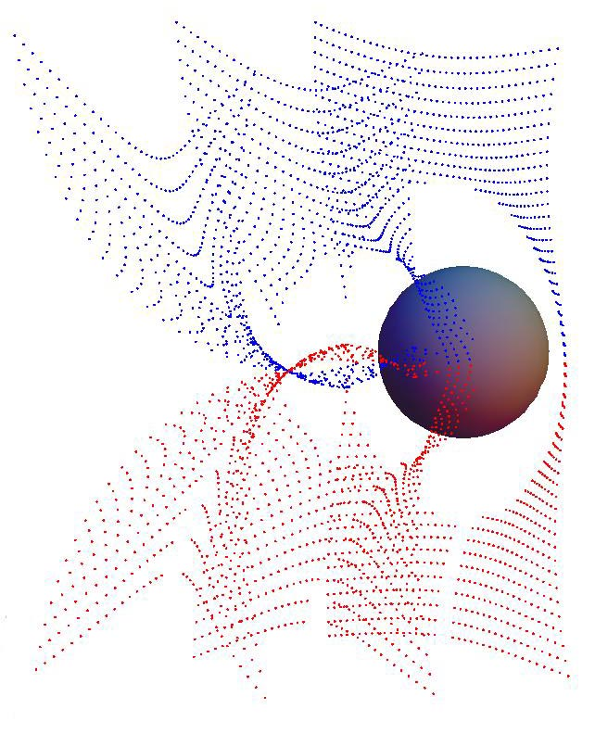
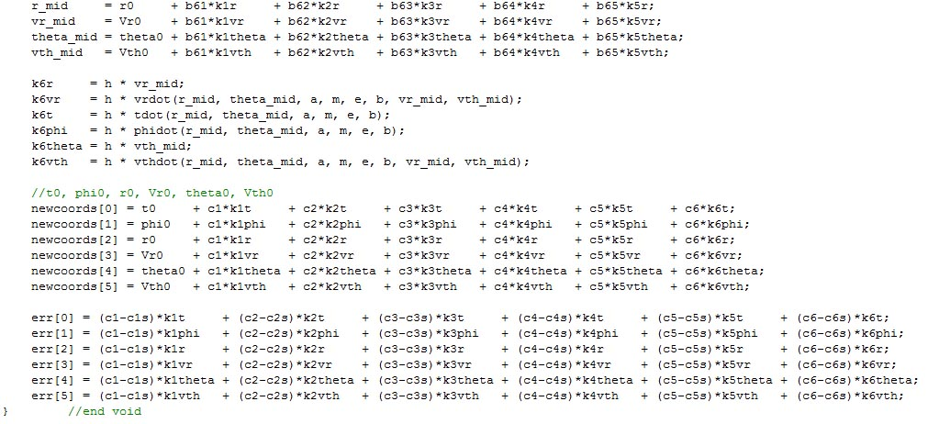
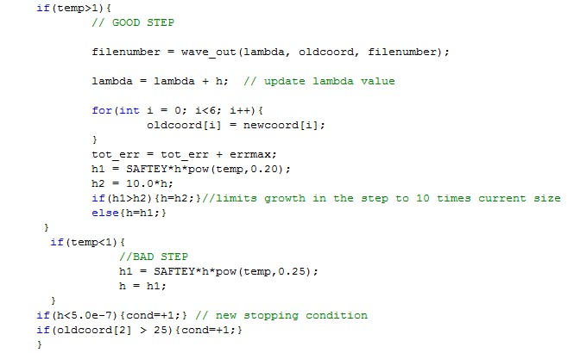
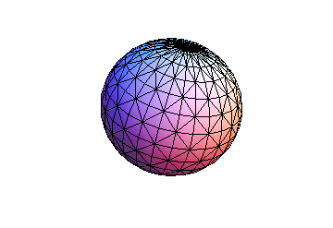
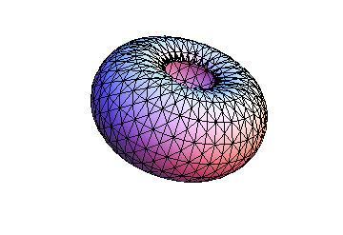
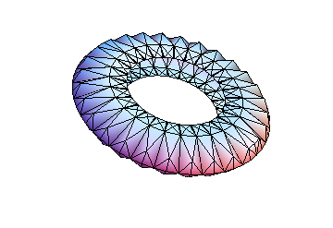
Optical wave-fronts and wave-front singularities surrounding a rotating black hole.
Scott Johnson, John Rossman, Charles Harnden, Rob Schweitzer, Scott Schlef Department of Physics, Bridgewater State College // Bridgewater MA, 02325
Mentor: Dr. Thomas Kling
Abstract:
In gravitational lensing theory, the shape of the wave-front of a point light source can be used to determine the magnification and multiplicity of observed images. To date, no studies have been published that show the evolution of wave-fronts near rotating or Kerr black holes. Kerr black holes are found at the centers of all spiral galaxies. Using advanced numerical calculation techniques we will simulate light wave fronts around the black hole with different parameters such as angular momentum, mass, and charge. We will analyze the results using two and three-dimensional graphical displays for different scenarios. We have completed computer code that has calculated several wave-front progressions, and we have shown that the results properly simulate light around rotating black holes. We are currently working on locating caustics, points at which a wave front folds onto itself after passing by a black hole.
Wave-front singularities:
The point where the wave fronts cross are called wave-front singularities. The envelope of the wave-front singularities is the caustic. Most recently, this is the area we are investigating.
The Program:
In fall 2008 and spring 2009, we created the program that integrated light rays then progressed to wave fronts around a Kerr Black Hole. A Runge Kutta 4th Order algorithm was employed for the integration, combined with monitoring the Lagrangian made for excellent error control. Additionally, programming in teams in the classroom allowed us to catch human error. Here is a sample of the RK4 algorithm:
Black Holes:
When a star’s inner pressure cannot withstand the pull of gravity it can collapse to a point of infinite density, called a black hole. A black hole can be described with just 3 parameters, a the angular momentum, m the mass, and e the charge. For physical black holes, the black hole is electrically neutral, e=0 and the angular momentum is much less than the mass, a<<m.
The simplest description of a black hole is called Schwarzschild Metric, which describes a non-rotating and non-charged (a=0 and e=0) black hole. The metric is a mathematical equation that captures all the information of the space-time. With the metric, we can find structures of the black hole, the first being the event horizon. The event horizon is a spherical surface at which point nothing can escape the pull of gravity. Inside the event horizon at the center is the singularity, a point of zero volume and infinite density (where all the mass is located at).
In the case we studied, a is not equal to zero, which means the black hole is rotating. The name for this is a Kerr Black Hole. The Kerr Black Hole has an additional structure, called the ergosphere. The ergosphere is a surface where any object is forced to rotate with the black hole. Above are parametric plots of the ergosphere as the angular momentum becomes greater than the mass of the black hole.
The Lagrangian:
Light rays take the shortest paths in curved space-time and using the metric we can construct the Lagrangian, which will us to make the Euler-Lagrange equations.
Dealing with data loss
The Lagrangian
The Euler-Lagrange Equation
Differential Equations:
Method: Using the Euler-Lagrange equation we have two second order and two first order ordinary differential equations. Implementing constants of integrations, using our choice of coordinates, and then using auxiliary variables we are left with six coupled first order ODEs. These equations describe the motion for light rays surrounding a Kerr Black Hole.
The Metric:
The Kerr Metric has the following functional form:
Outputting the data for Mathematica
Acknowledgements:
ATP Semester Grant, Dr Kling and Dr. Arlie Petters of Duke University

