Slide 1
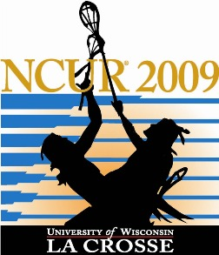
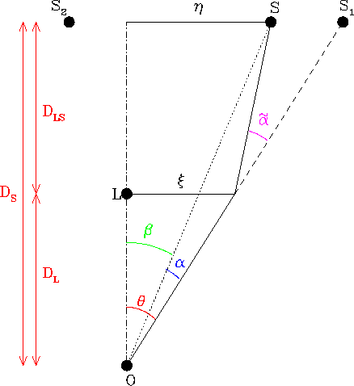
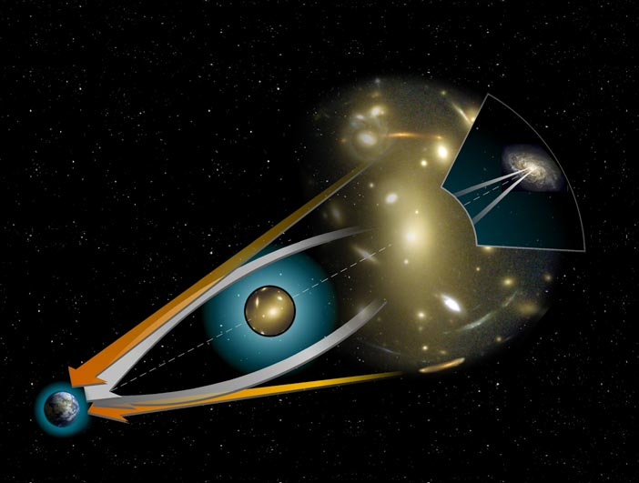
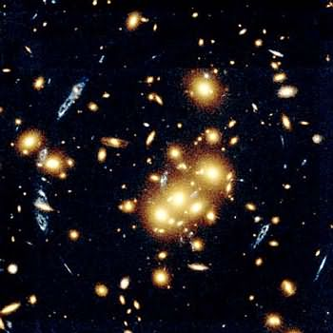
Examining the Accuracy in Weak Gravitational Lensing
Christopher Cepero
Mentor: Dr. Thomas Kling
Department of Physics, Bridgewater State College: Bridgewater MA, 02325
Abstract:
Weak gravitational lensing is a relativistic idea that involves image distortion, or the stretching and shearing of a perceived image. This research project examines the thin-lens approximation for weak gravitational lensing by computing an exact treatment of weak gravitational lensing based on general relativity. We write a c++ program to integrate weak gravitational lensing equations, while accounting for elongation and shear in light rays. By utilizing the Runge-Kutta adaptive step method, we are able to create a computer program to integrate the Euler-Lagrange equations that describe the path of light to yield the geodesics. We then integrate the geodesic deviation equations to determine the distortion patterns. Our goal is to write a program that will numerically integrate the Euler Lagrange equations to model weak gravitational lensing. We anticipate that this method will yield values more accurately than by the use of thin lens approximation.
How gravitational Lensing is studied:
Gravitational Lensing can be studied by observation, and by modeling it with computer code. While observational study is possible, it is much more useful to model lensing. Currently, there are two ways to model gravitational lensing. The first is to us the thin lens approximation. The second is to model it by calculating the path light travels in it’s entirety.
Light Path:
The original RFK-model we began with was written by Dr. Kling and his collaborators. Originally it ran the calculation from the observer to the source, so we altered it to perform the more appropriate calculation from the source to the observer. We also made three new function of the form as follows.
double eta_int(double z, double r, double rs, double tau, double delta_c){
double al, x, om, Hsq, M0, term, pot, eta_return;
al = 1.0/(1.0+z);
x = al*r/rs;
om = 0.3;
Hsq = H*H*(om/al/al/al +(1.0-om));
M0 = 1.5*delta_c*Hsq*rs*rs*rs;
term = atan(x/tau)*(1.0/tau-tau-2.0*tau/x);
term = term + log((1.0+x*x/tau/tau)/(1.0+x)/(1.0+x))*((tau*tau-1.0)/2.0/x - 1.0);
term = term + PI*(tau*tau-1.0)/2.0/tau - 2.0*log(tau);
pot = M0*tau*tau/rs/(1.0+tau*tau)/(1.0*tau*tau)*(term);
eta_return = (1.0-2.0*pot);
return eta_return;
}//close function
Our Model vs. Thin Lens Model:
The difference begins with the fact that our model considers how light is affected in the entirety of it’s journey. Our model also makes use of the geodesic deviation equations to account for the stretching of light.
What is Gravitational Lensing:
Gravitational Lensing is a phenomenon that effects images we see of a source of light. The types of effects vary, from stretching the image out to duplicating it. This is a result of light traveling in curved space, which is caused by a massive object in space. Gravitational lensing can be divided into two classes: strong lensing and weak lensing.
Geodesic Deviation:
The geodesic deviation is completely new code we wrote over the summer. It required four of the functions shown below, each with 5 subfunctions.
Thin Lens Approximation
double yoy(double ell[], double Y[], double p[]){
double t, x, y, z;
t = p[0];
x = p[1];
y = p[2];
z = p[3];
double r = sqrt(x*x + y*y + z*z);
double p_xx, p_xy, p_xz;
.
. (~20 lines of code removed)
.
double yoy_return;
yoy_return = p_yy*ell[0]*ell[2]*Y[0] - p_yy*ell[0]*ell[0]*Y[2];
yoy_return = yoy_return + p_yx*ell[0]*ell[1]*Y[0] - p_yx*ell[0]*ell[0]*Y[1];
yoy_return = yoy_return + p_yz*ell[0]*ell[3]*Y[0] - p_yz*ell[0]*ell[0]*Y[3];
yoy_return = yoy_return + (p_yy + p_xx)*ell[1]*ell[2]*Y[1] - (p_yy + p_xx)*ell[1]*ell[1]*Y[2];
yoy_return = yoy_return + (p_yy + p_zz)*ell[3]*ell[2]*Y[3] - (p_yy + p_zz)*ell[3]*ell[3]*Y[2];
yoy_return = yoy_return + p_xz*ell[1]*ell[2]*Y[3] - p_xz*ell[1]*ell[3]*Y[2];
yoy_return = yoy_return + p_zx*ell[3]*ell[2]*Y[1] - p_zx*ell[3]*ell[1]*Y[2];
yoy_return = yoy_return - p_yz*ell[1]*ell[1]*Y[3] + p_yz*ell[1]*ell[3]*Y[1];
yoy_return = yoy_return - p_yx*ell[3]*ell[3]*Y[1] + p_yx*ell[3]*ell[1]*Y[3];
return yoy_return;
}//close function
Computer Code:
Overview: Our original code modeled the continuous bending/integration of the light bundle, which means there is no approximation. We modified the previous code for paths and have added new code to calculate the change in shape of the light. In addition, we have expanded the existing adaptive step-size algorithm for all differential equations.
Equations for the path:
Strong Gravitational Lensing: Causes multiple images. Needs an extremely
massive lensing object.
New Lagrangian and Euler-Lagrange equations
Other code work / modifications:
Adaptive step-size code was modified to include integrating geodesic deviations equations.
Total new functions written: 12
Total new lines of code: 1200
Total lines of code: 2000
Three copies of things looking like
Weak Gravitational Lensing: Causes the image to stretch and rotate.
Equations for the Shape:
Why we care:
Gravitational Lensing is a valuable tool in astrophysics. It is used to predict the distribution of matter in the universe, and is also used to calculate the mass density of lensing objects. Furthermore, gravitational lensing is used in studies of black holes.
General geodesic deviation equation
Current Project Status:
We have a complete code that should integrate the shape parameters. The code runs if the adaptive step-size is turned off for the shape, but the shapes look wrong. In addition, the size of the error in the shape integration looks too large.
Question remaining: Is the problem a programming bug or conceptual error?
Wrote four versions of this segment of code.
Acknowledgements:
Joachim Wambsganss, "Gravitational Lensing in Astronomy", Living Rev. Relativity 1, (1998), 12. URL (cited on
<date>): http://www.livingreviews.org/lrr-1998-12
HubbleSite. HubbleSite. 2000. 6 Aug. 2008
<http://hubblesite.org/newscenter/archive/releases/2000/07/image/c/>.
Dr Kling and Collaborators

