Slide 1
Expand Your Horizons
Traveling to Crewe, England
Teaching at St. Mary’s Primary School

Slide 2
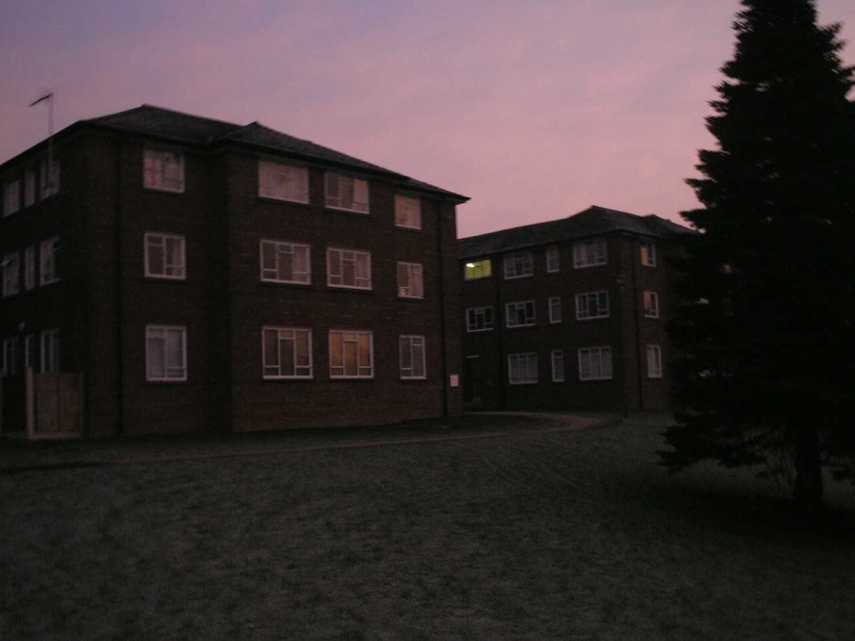
Accommodations At MMU
Stay and experience life at Manchester Metropolitan University. The campus is located just a minutes walk from Crewe’s Train Station. The town centre is easily accessible as well.

Slide 3
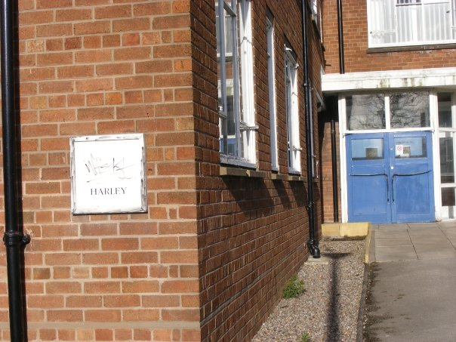
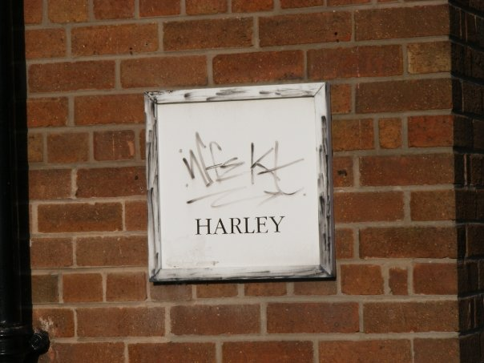

Slide 4
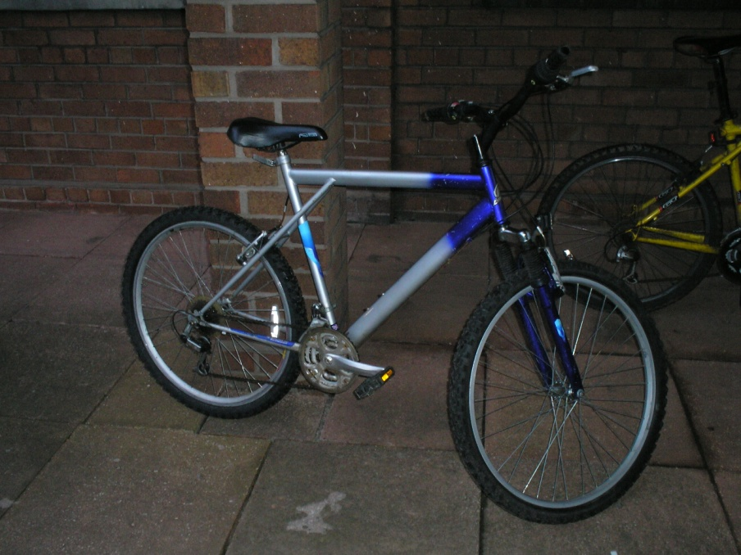
It’s a 2.5 mile walk to St. Mary’s school. You might choose to ride a bike. It’s really not that bad of a walk though, it takes about a half hour or so and with a friend it doesn’t seem that far.
The Campus in Crewe is a sub-campus of Manchester. There is also a campus in Alsager which is only a bus ride away. At the Alsager campus you can find a complete gym and swimming pool.

Slide 5
Travel On The Weekends!
This program allows you to have a 3 day weekend. It gives you enough time to see the sights and shop in the cities!
Chester
Manchester
Liverpool
PRIMARK
These are just some examples of the amazing things you could easily travel to.

Slide 6
CHESTER
This city centre is rich with history and fun places to see. There is a wall surrounding the city. Walk along this to see some beautiful sights!!

Slide 7
CHESTER

Slide 8
CHESTER
The UK’s largest Zoo is located in Chester. It is incredible. They have so many different types of animals. As teachers make sure you go there!

Slide 9
MANCHESTER

Slide 10
MANCHESTER
Make sure you go here….

Slide 11
LIVERPOOL
If you weren’t aware, Liverpool is home to the Beatles. Find Albert Dock and go on the Beatles tours!

Slide 12
LIVERPOOL
This is the mall…

Slide 13
PRIMARK
This clothing store is insane. There is one in Liverpool, Manchester, Hanley, etc. It’s like a classy Walmart.

Slide 14
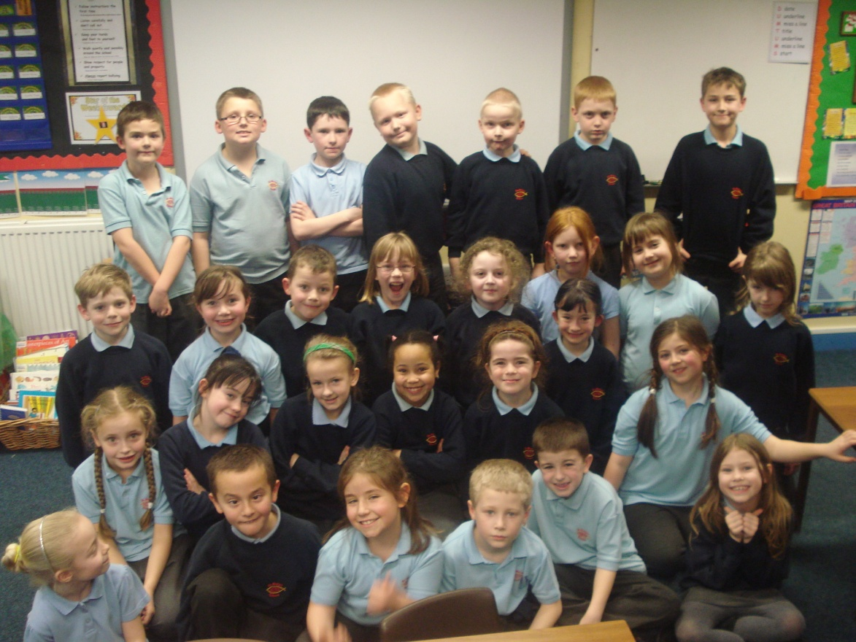
Teaching at St. Mary’s
My experiences at St. Mary’s will last a life time. Be prepared to learn. Even though the language spoken is English, the slang terms are so different. You will get to see a different approach of teaching. The British curriculum is very different compared to the Massachusetts curriculum.

Slide 15
Experience the SMART BOARD

Slide 16
Meet Class 10!!!

Slide 17
I had the privilege of working with Mrs. Ayre and Mrs. Hewitt’s year 3 class. They are between 7 and 8 years old, comparable to a second grade class. They were very welcoming.

Slide 18
When Friends Become Family
Rock Climbing in the Peak District!
Making friends with the other students at the university helped expand our horizons. Having friends that know the area and have cars can help you see many sights that you cannot get to on the bus or train. Eating your meals inside the cafeteria or just walking around during the day will help your overall experience.

Slide 19
I highly suggest you take a look at being a part of something bigger than Massachusetts. It is only for a part of a semester. The price wasn’t out of control. As a college student who pays tuition and bills, I took out a small loan. It is possible!!!!

